Slide 1
A sample of data visualisations illustrating trends in variables of economic and social importance

Slide 2
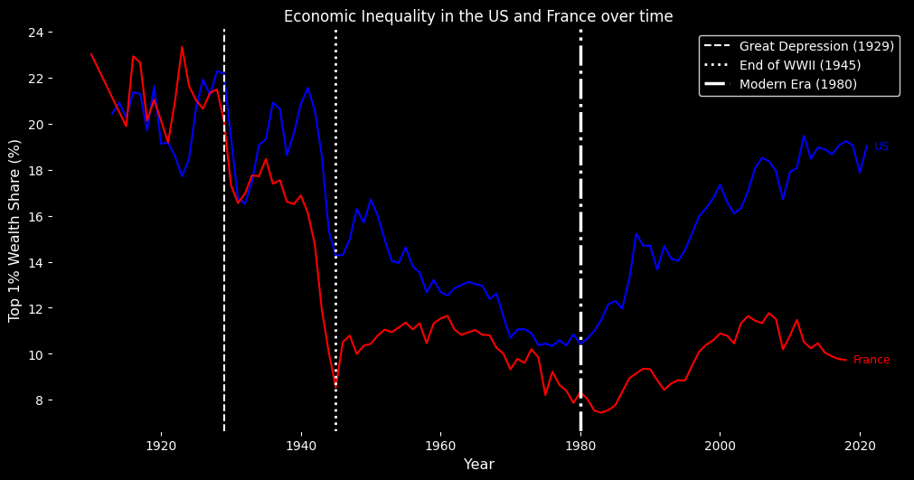
Wealth inequality in the US and France over time

Slide 3
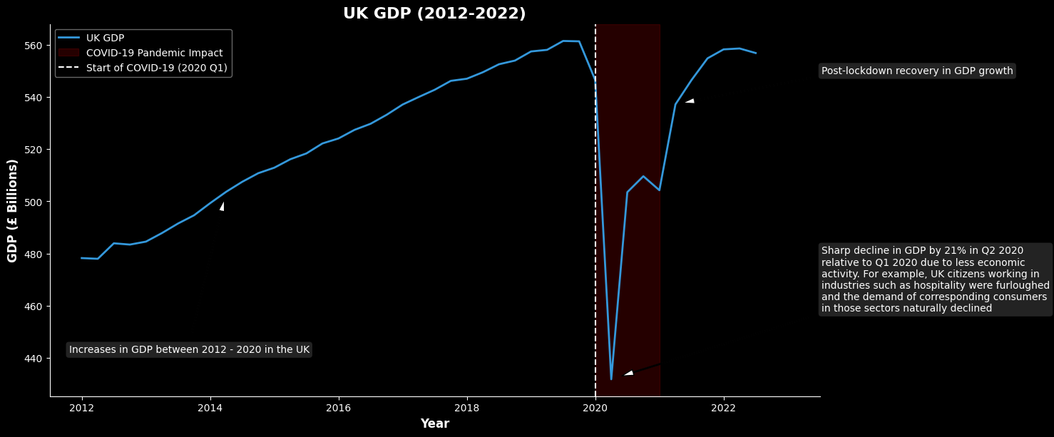
UK GDP Growth 2012 - 2022

Slide 4
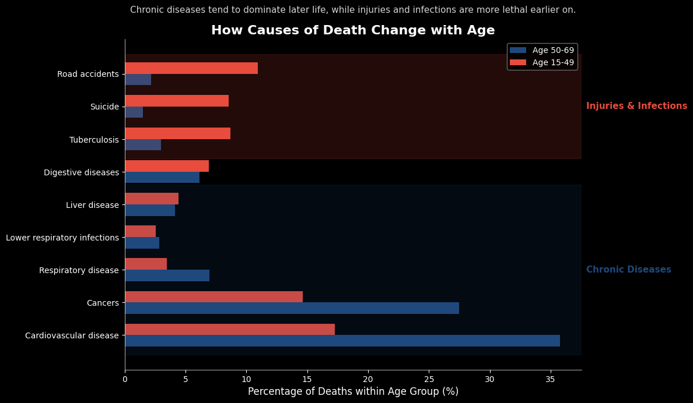
Causes of death with age

